Slide 1
UNIT - 5

Slide 2
PART – I
System Protection
Goals of protection
Principles and domain of protection
Access matrix
Access control
Revocation of access rights.

Slide 3
PROTECTION
The processes in an operating system must be protected from one another’s activities.
To provide such protection, we can use various mechanisms to ensure that only processes that have gained proper authorization from the operating system can operate on the files, memory segments, CPU, and other resources of a system.
Protection refers to a mechanism for controlling the access of programs, processes, or users to the resources defined by a computer system.
This mechanism must provide a means for specifying the controls to be imposed, together with a means of enforcement

Slide 4
Goals of protection
To prevent malicious misuse of the system by users or programs. See chapter 15 for a more thorough coverage of this goal.
To ensure that each shared resource is used only in accordance with system policies, which may be set either by system designers or by system administrators.
To ensure that errant programs cause the minimal amount of damage possible.
Note that protection systems only provide the mechanisms for enforcing policies and ensuring reliable systems. It is up to administrators and users to implement those mechanisms effectively.

Slide 5
Principles of protection
The principle of least privilege dictates that programs, users, and systems be given just enough privileges to perform their tasks.
This ensures that failures do the least amount of harm and allow the least of harm to be done.
For example, if a program needs special privileges to perform a task, it is better to make it a SGID program with group ownership of "network" or "backup" or some other pseudo group, rather than SUID with root ownership. This limits the amount of damage that can occur if something goes wrong.
Typically each user is given their own account, and has only enough privilege to modify their own files.
The root account should not be used for normal day to day activities - The System Administrator should also have an ordinary account, and reserve use of the root account for only those tasks which need the root privileges

Slide 6
Domain of protection
A computer can be viewed as a collection of processes and objects ( both HW & SW ).
The need to know principle states that a process should only have access to those objects it needs to accomplish its task, and furthermore only in the modes for which it needs access and only during the time frame when it needs access.
The modes available for a particular object may depend upon its type.

Slide 7
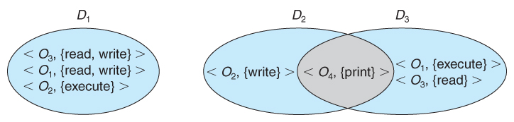
Domain Structure
A computer can be viewed as a collection of processes and objects ( both HW & SW ).
The need to know principle states that a process should only have access to those objects it needs to accomplish its task, and furthermore only in the modes for which it needs access and only during the time frame when it needs access.
The modes available for a particular object may depend upon its type.
Fig. System with three protection domains.

Slide 8
The association between a process and a domain may be static or dynamic.
If the association is static, then the need-to-know principle requires a way of changing the contents of the domain dynamically.
If the association is dynamic, then there needs to be a mechanism for domain switching.
A domain can be realized in a variety of ways:
Each user may be a domain. In this case, the set of objects that can be accessed depends on the identity of the user. Domain switching occurs when the user is changed—generally when one user logs out and another user logs in.
Each process may be a domain. In this case, the set of objects that can be accessed depends on the identity of the process. Domain switching occurs when one process sends a message to another process and then waits for a response.
Each procedure may be a domain. In this case, the set of objects that can be accessed corresponds to the local variables defined within the procedure. Domain switching occurs when a procedure call is made.

Slide 9
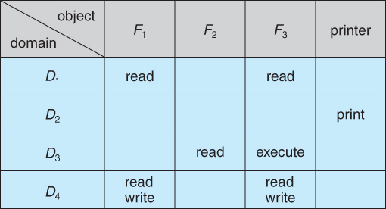
ACCESS MATRIX
The model of protection that we have been discussing can be viewed as an access matrix, in which columns represent different system resources and rows represent different protection domains. Entries within the matrix indicate what access that domain has to that resource.
Access matrix

Slide 10
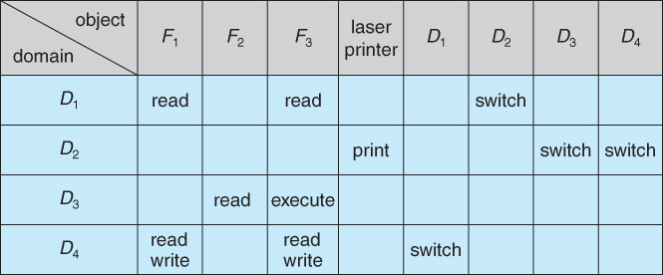
Domain switching can be easily supported under this model, simply by providing "switch" access to other domains:
Access matrix with domains as objects.

Slide 11
The ability to copy rights is denoted by an asterisk, indicating that processes in that domain have the right to copy that access within the same column, i.e. for the same object. There are two important variations:
If the asterisk is removed from the original access right, then the right is transferred, rather than being copied. This may be termed a transfer right as opposed to a copy right.
If only the right and not the asterisk is copied, then the access right is added to the new domain, but it may not be propagated further. That is the new domain does not also receive the right to copy the access. This may be termed a limited copy right, as shown in Figure below

Slide 12
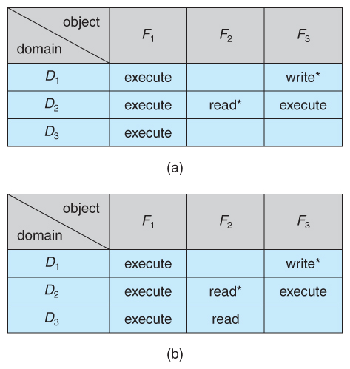
Access matrix with copy rights.

Slide 13
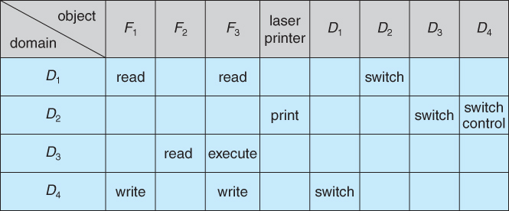
Copy and owner rights only allow the modification of rights within a column. The addition of control rights, which only apply to domain objects, allow a process operating in one domain to affect the rights available in other domains.
For example in the table below, a process operating in domain D2 has the right to control any of the rights in domain D4.
Modified access matrix

Slide 14
Implementation of Access Matrix:
1. Global Table
The simplest approach is one big global table with < domain, object, rights > entries.
Unfortunately this table is very large ( even if sparse ) and so cannot be kept in memory ( without invoking virtual memory techniques. )
There is also no good way to specify groupings - If everyone has access to some resource, then it still needs a separate entry for every domain.
2. Access Lists for Objects
Each column of the table can be kept as a list of the access rights for that particular object, discarding blank entries.
For efficiency a separate list of default access rights can also be kept, and checked first.

Slide 15
3. Capability Lists for Domains
In a similar fashion, each row of the table can be kept as a list of the capabilities of that domain.
Capability lists are associated with each domain, but not directly accessible by the domain or any user process.
Capability lists are themselves protected resources, distinguished from other data in one of two ways:
A tag, possibly hardware implemented, distinguishing this special type of data. ( other types may be floats, pointers, booleans, etc. )
The address space for a program may be split into multiple segments, at least one of which is inaccessible by the program itself, and used by the operating system for maintaining the process's access right capability list.

Slide 16
4. A Lock-Key Mechanism
Each resource has a list of unique bit patterns, termed locks.
Each domain has its own list of unique bit patterns, termed keys.
Access is granted if one of the domain's keys fits one of the resource's locks.
Again, a process is not allowed to modify its own keys.
5. Comparison
Each of the methods here has certain advantages or disadvantages, depending on the particular situation and task at hand.
Many systems employ some combination of the listed methods.

Slide 17
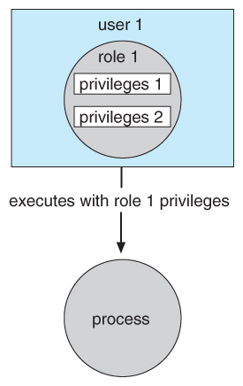
Access control
Role-Based Access Control, RBAC, assigns privileges to users, programs, or roles as appropriate, where "privileges" refer to the right to call certain system calls, or to use certain parameters with those calls.
RBAC supports the principle of least privilege, and reduces the susceptibility to abuse as opposed to SUID or SGID programs.

Slide 18
Revocation of Access Rights
The need to revoke access rights dynamically raises several questions:
Immediate versus delayed - If delayed, can we determine when the revocation will take place?
Selective versus general - Does revocation of an access right to an object affect all users who have that right, or only some users?
Partial versus total - Can a subset of rights for an object be revoked, or are all rights revoked at once?
Temporary versus permanent - If rights are revoked, is there a mechanism for processes to re-acquire some or all of the revoked rights?
With an access list scheme revocation is easy, immediate, and can be selective, general, partial, total, temporary, or permanent, as desired.

Slide 19
With capabilities lists the problem is more complicated, because access rights are distributed throughout the system. A few schemes that have been developed include:
Reacquisition - Capabilities are periodically revoked from each domain, which must then re-acquire them.
Back-pointers - A list of pointers is maintained from each object to each capability which is held for that object.
Indirection - Capabilities point to an entry in a global table rather than to the object. Access rights can be revoked by changing or invalidating the table entry, which may affect multiple processes, which must then re-acquire access rights to continue.
Keys - A unique bit pattern is associated with each capability when created, which can be neither inspected nor modified by the process.
A master key is associated with each object.
When a capability is created, its key is set to the object's master key.
As long as the capability's key matches the object's key, then the capabilities remain valid.
The object master key can be changed with the set-key command, thereby invalidating all current capabilities.
More flexibility can be added to this scheme by implementing a list of keys for each object, possibly in a global table.

Slide 20
Thank you

